Slide 1
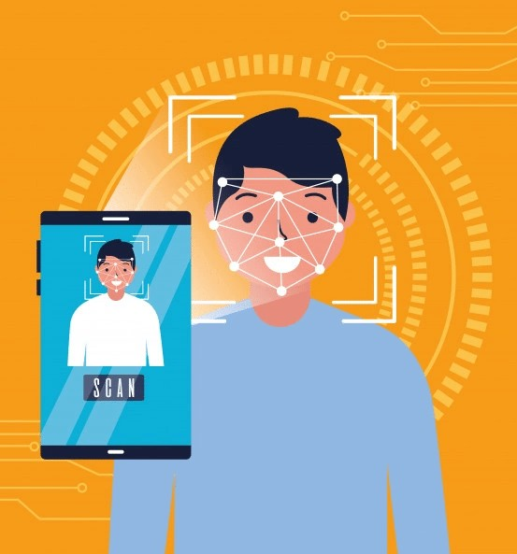
FACE RECOGNITION ATTENDANCE SYSTEM
Name: Harsh Kesarwani
Ayush Kamble
Kunal Chauhan
Guide Name: Debarati Ghosal

Slide 2
INTRODUCTION
HARDWARE & SOFTWARE
STUDENT
ADMIN
CONCLUSION
FUTURE SCOPE
TABLE OF
CONTENT

Slide 3

INTRODUCTION
Every college require an attendance system to maintain record of present student.
Face Recognition Attendance System is developed for the Faculty to maintain attendance record.
It uses facial recognition technology to identify the person’s facial features and automatically mark attendance which is very fast enough than previous method.

Slide 4










SOFTWARE
HARDWARE
Computer (i5, 4gb)
Windows 10
Camera
Python
Hard Disk:- 1TB
Visual Studio Code

Slide 5









STUDENT DETAILS
TRAIN
SAMPLE
PHOTO
SAMPLE
DATA
IMPORT
EXPORT
SAVE
RESET
UPDATE
DELETE

Slide 6








CAMERA
ADMIN
ATTENDANCE
STUDENT
DETECTION

Slide 7


CONCLUSION
Before the development of this project. There are many loopholes in the previous method while taking attendance using old method which caused many troubles to most of the institutions.
Therefore, the facial recognition feature method is secure enough, reliable and available for use. It saves time and lot of effort, especially if it is a lecture with huge number of students

Slide 8


FUTURE SCOPE
Some of the future enhancements that can be done to this system are as follows:
Facility of Defaulter list in which system update the defaulter student.
In future we can update the modules like take attendance of a face in a single run.

Slide 9

Thank You!

